Slide 1
Section 1.5 Solving Rational Expressions

Slide 2
Review) Non Permissible Values (NPV)
Any value of “x” (Variable) that makes the denominator equal to zero
Ie: Find the NPV
Look at the Denominator
Make each denominator equal to zero and solve for “x”

Slide 3
I) What is a Rational Function?
A Rational Function is a function where you have one polynomial function dividing another polynomial function.

Slide 4
Ex#1) Indicate which of the following expressions are Rational Functions:

Slide 5
II) Solving Rational Equations
“Solving” means finding the value of “x” where both sides of an equation are equal
On a graph, it’s where the two functions cross/intersect each other
Steps to Solve Algebraically
Find the NPV (Non-Permissible Values)
Find the LCD
Multiply all terms by LCD to cancel out the Denominator
Simplify and Solve for ‘x’
‘x’ can not be the same as the NPV (Extraneous Root)

Slide 6
NOTE: Solving VS Simplifying
Simplifying: Reducing an equation to a simplified form
Solving: Finding a value for the variable so that both sides of the equation will be EQUAL!!!
When solving, your equation will have an “equal” sign, simplifying doesn’t!!!
LCD:
NPV
Multiply all terms by LCD, not just terms with a denominator!
Now check your answer:

Slide 7
Practice: Solve each of the following
LCD:
LCD:

Slide 8
III) Equations with Extraneous Roots or No Solutions
Extraneous solutions are answers that are not allowed
This happens when the solution is the same as the NPV
An equation will have no solutions when both sides are not equal OR when all the variables are eliminated
In contrast, an equation will have infinite solutions when both sides are equal when all variables are gone
With all variables gone, both sides
are not equal. So, no matter what “x” equals, both sides will never be equal. Which means you will have no solutions!
There are infinite solutions

Slide 9
Ex: Solve and Find the NPV

Slide 10
Practice: Solve the following and check for extraneous Roots

Slide 11
Practice: Solve
Find the NPV:
Find the NPV:
Find the LCD:
Find the LCD:
We have an extraneous root, so, no solutions

Slide 12
Challenge: Solve
LCD:

Slide 13
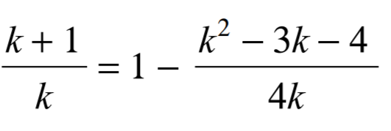
The following work was shown in solving the equation below. AT which step was the first mistake made?
a) The first mistake is in step 1
b) The first mistake is in step 2
c) The first mistake is in step 4 because terms were incorrectly cancelled out
d) The first mistake is in step 7 because one of the answer is extraneous
e) There are no mistakes in all the steps and both answers are correct

Slide 14
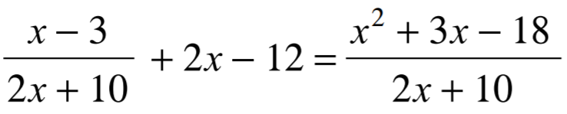
The following work was shown in solving the equation below. AT which step was the first mistake made?
a) The first mistake is in step 1, you can’t move an entire rational expr. to the opposite side
b) The first mistake is in step 3
c) The first mistake is in step 4
d) The first mistake is in step 5 because you can not cancel the binomials
e) The first mistake is in steps 7 because x=-5 is not included as one of the answers
f) There are no mistakes and all the steps are correct

